Slide 1
MINOR PROJECT
BLOCKCHAIN POWERED CROSS-BORDER PAYMENTS PLATFORM

Slide 2
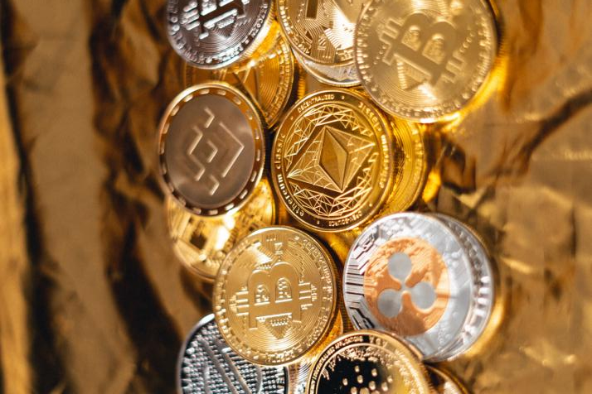
01.Problem Statement
Problem:
In the current system, online transactions and payments work on a centralized system that causes a lot of problems and adds unnecessary transaction charges.

Slide 3
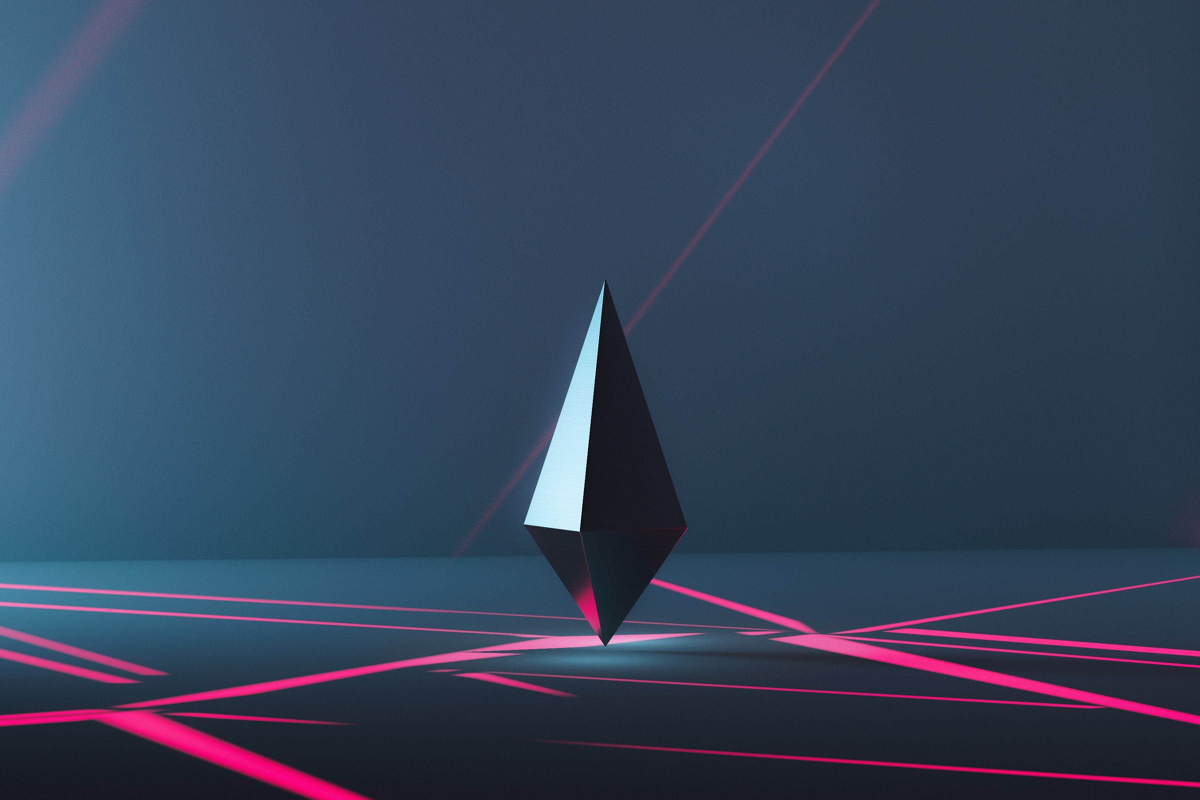
02. INTRODUCTION
BlockChain
A blockchain is a digital ledger of transactions that is duplicated and distributed across the entire network of computer system on the blockchain. It is a system of recording information in a way that makes it difficult or impossible change or hack. The key element that make blockchain immutable is cryptographic hashes.
Cryptography+ Blockchain hashing = Immutability
Blocks
Every chain consists of multiple blocks and each block has three basic elements:
Data -that is stored in the block
hash - that is calculated using the data
the hash of the previous block

Slide 4
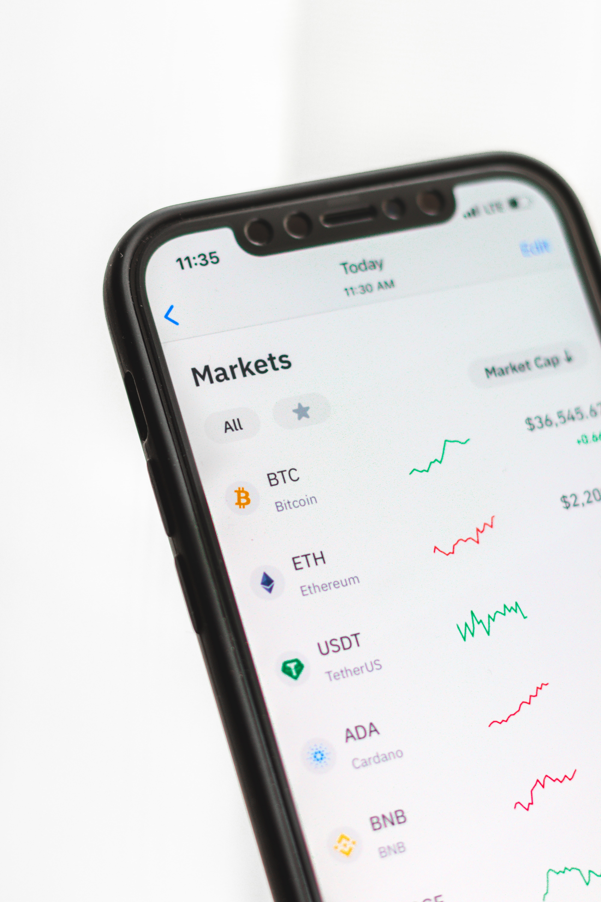
Ethereum
For development of Krypt using Blockchain we have used Ethereum - a popular platform for creating distributing Blockchain applications that support amart contracts. Ether is the native cryptocurrency of the platform.
Smart Contracts
These self executing contracts which contain the terms and conditions of agreement between peers
They typically are used to automate the execution of an agreement so that all participants can be immediately certain of the outcome , without any intemediary involvement or time loss.

Slide 5

Solidity
Solidity is a contract-oriented , high -level language for implementing smart contracts. It is statically typed, supports inheritance, libraries and complex user-defined types among other features.
MetaMask
For performing any transactions on the blockchain we require an account which will have unique account address. This can be created by using the Metamask chrome extension.
Metamask is a crypt wallet & gateway to blockchain apps.
It helps users in interacting with the blockchain network.

Slide 6
03. IMPLEMENTATION
Front-End
Back-End: Blockchain
HTML
CSS
JavaScript
React JS
Solidity smart contract using Hardhat on the ethereum network
Pairing ethereum wallet using metamask

Slide 7

04. ISSUES TO SOLVE
Problems with the current available payment system that we solved
Transaction Speed
Transaction Cost
Transaction Opacity

Slide 8
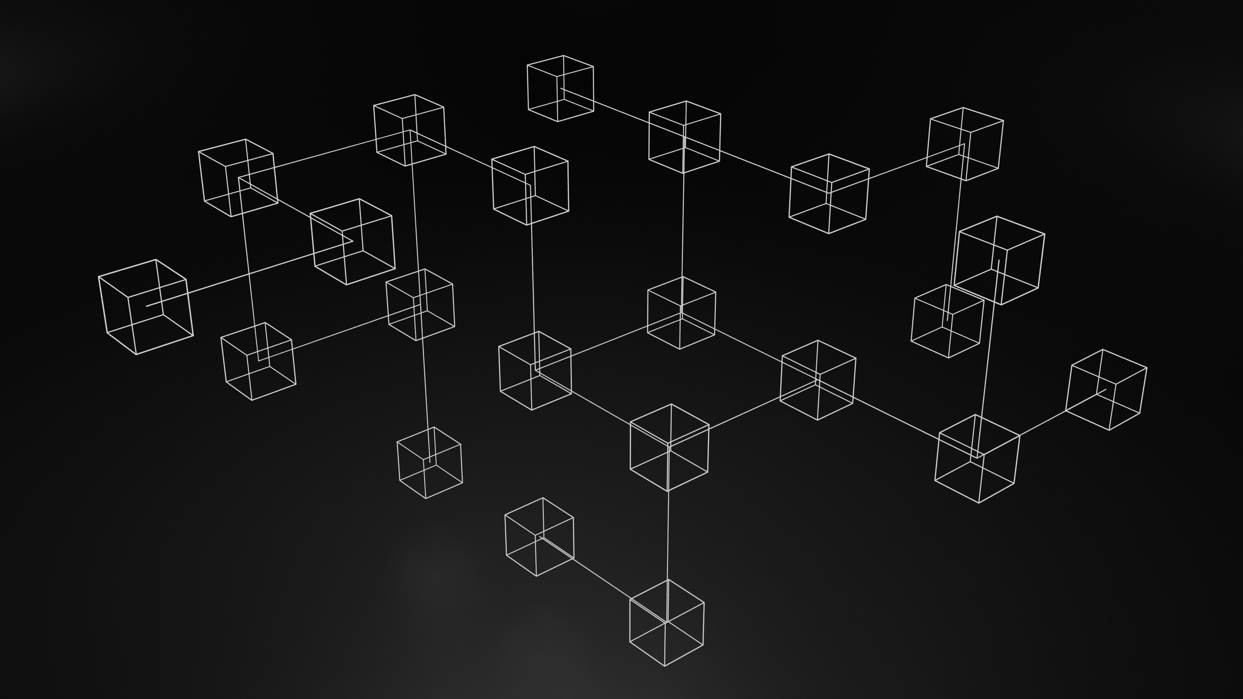




05. SOLUTION
How our application solves the problems
Removes Intermediaries
Transparency & Security
No need for broker/brokerages.
Only minimum gas fees required.
No middlemen used
Completely transparent. Sender and receiver can track and view all details of payments anytime. Authenticated using highly secure MetaMask
Safe & Quick
Automation
Takes very less time for successfull transactions to be carried out. It is safe to use.
Use of smart contracts makes the system decentralized hence datat cannot be tampered with.

Slide 9
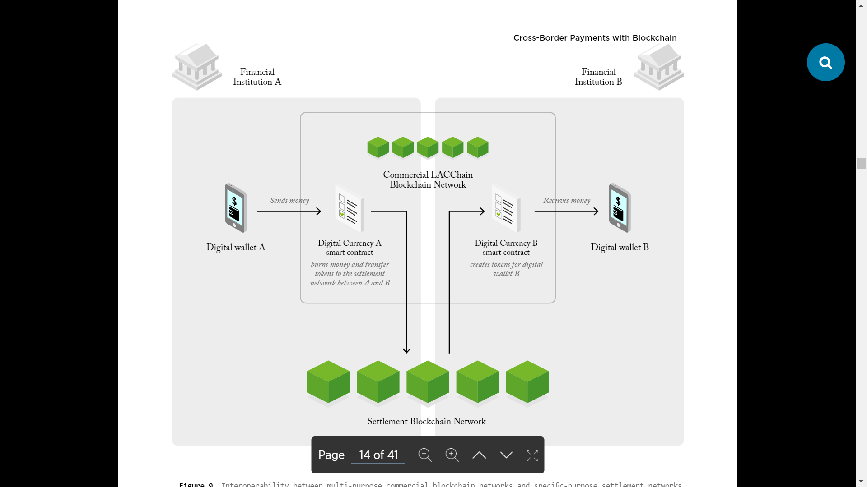
06. WORKING OF THE APPLICATION

Slide 10
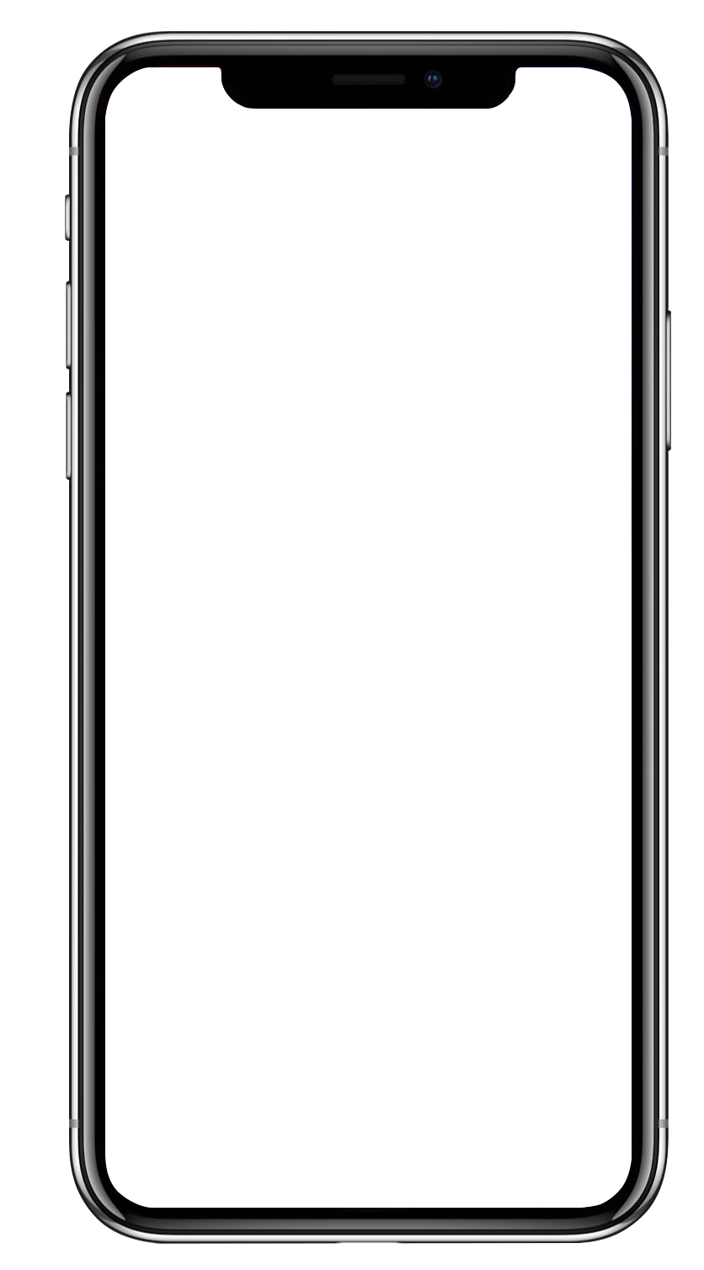

07. ADDITIONAL FEATURES
08. FUTURE SCOPE
Connect to MetaMask
Fetch NFTs
Allows easy connection to Metamask wallet without which payments won’t happen
Similar to GIFs, NFTs can also be fetched in the future
Send money cross platform
Implement Live Chat room
Money or cryptocurrency, such as Ethereum can be sent across networks with ease and no charges
We plan to create a public chat room for crypto enthusiasts to interact in
Unique GIF
Connect Twitter
Using Giphy API, unique GIFs are fetched for every transaction stored in the blockchain
We plan to connect Twitter API to fetch crypto news in real time

Slide 11
THANK YOU
Now, we would present a live demo of our application

